Slide 1
SOFTWARE IMPLEMENTATION

Slide 2
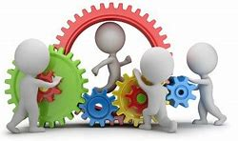
Managing Construction & Tools

Slide 3

Managing Construction
During the construction of a software, a number of key issues are critical to the overall integrity and functionality of the software solution
Minimizing complexity
Anticipating change
Constructing software solutions for verification
Constructing software using standards
We have looked at these during the construction

Slide 4
Managing Construction
Management of Implementation would involve looking at it from two perspectives
Proceeding as planned?
Technical quality?
Typical measures: effort expenditure and rate of completion
Typical measures: Lines of code developed, number of defects found in testing etc.
Adjustments to plan based on milestones beaten, met or missed
Can be useful when adjusting the construction plans and processes

Slide 5
Managing Construction : Construction Quality
The measures and measurements which help in understanding the quality would be in terms of “Productivity & Progress with respect to the plans” and “Code quality”
Development Progress and productivity metrics (Proceeding as Planned)
Measures for this would be number of active days spent, assignment scope completed, productivity, efficiency, code churn etc.
Metrics could be in terms of LoC/effort days, LoC generated/purged etc.
How easy is the system to debug, troubleshoot, maintain, integrate and, extend with new functionality (Technical Quality)
Measures for this would be obtained from static code analysis which would include Lines of Code (LOC), code complexity, Instruction Path Length etc.
Metrics would be in terms of No of review errors/KLoC (1000 LoC) etc.
Measurements should typically be deployed to only answer business questions.

Slide 6
Managing Construction : Quality for an Agile Scrum Project would be ..
Sprint Burndown as seen graphically is a key metric communicating the completion of work throughout the sprint based on story points. The goal of the team is to consistently deliver all work, according to the forecast
Team Velocity metric accounts for the “amount” of software or stories the team completes during a sprint. It can be measured in story points or hours, and you can use this metric for estimation and planning.
Throughput indicates the total value-added work output by the team. It is typically represented by the units of work (tickets) the team has completed within a set period of time.
Cycle Time stands for the total time that elapses from the moment when the work is started on an item (e.g., ticket, bug, task) until its completion.
… Escaped Defects, True test coverage

Slide 7
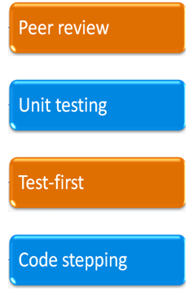
Managing Construction : Construction Technical Quality
Activities for ensuring construction quality include:
The process of writing code (in a framework or test harness) that will call the methods or functions in the code module under test and check the results
formal name for a common and informal process where the developer shows the
code to other developers, looking for advice or comment
Code being tested or reviewed is executed one statement at a time, and the debugger shows the values of variables & the flow of control as each statement executes
The practice of designing and building the test harness before writing the code that will be tested. Balances developers tendency to write tests to match their code

Slide 8
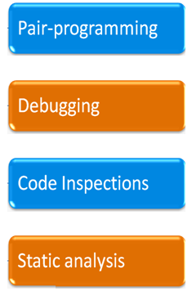
Managing Construction : Construction Quality
Activities for ensuring construction quality include: (Contd.)
Two developers work on same code, with one focusing on function logic and another on syntax and accuracy
The process of analyzing code to locate a known defect
Any process or tool that examines the code without executing it. E.g., peer review and code Inspections, static analysis tools
A formal process of peer review. Developer presents code for review to code inspectors

Slide 9
Code Review
Code Review, or Peer Code Review, is the act of consciously and systematically convening with one's fellow programmers to check each other's code for mistakes
Two heads are much better than one!
What to review for?
Correctness
Error handling
Readability
Coding standards / Coding guidelines
Optimization
Use Review checklists

Slide 10
Code Inspection
Software Inspection involves people examining the source representation with the aim of discovering anomalies and defects
Inspections can check conformance with a specification but not conformance with the customer’s real requirements
It’s a formalized approach to code/document reviews or peer reviews
Preconditions
A precise specification must be available.
Team members must be familiar with the organization standards.
Syntactically correct code or other system representations must be available.
An error checklist should be prepared.

Slide 11
Code Inspection
Inspection Procedure
Inspection Planning – selecting team, location and having the code/documents
System overview presented to inspection team as part of preparation
Code and associated documents are distributed to inspection team in advance.
Individuals prepare where every inspector will inspect the item
On the specified Inspection logging meeting, Inspection takes place & discovered errors are noted.
Owners identify modifications necessary, and make the modifications to repair errors discovered.
Re-inspection may or may not be required post the changes
All of these are documented and archived
Inspection Checklist
Checklist of common errors should be used to drive the inspection.
Error checklists are programming/language dependent & reflect the characteristic errors that are likely to arise in the language.
In general, the 'weaker' the type checking, the larger the checklist.
Examples: Initialization, Constant naming, loop termination, array bounds, etc.

Slide 12
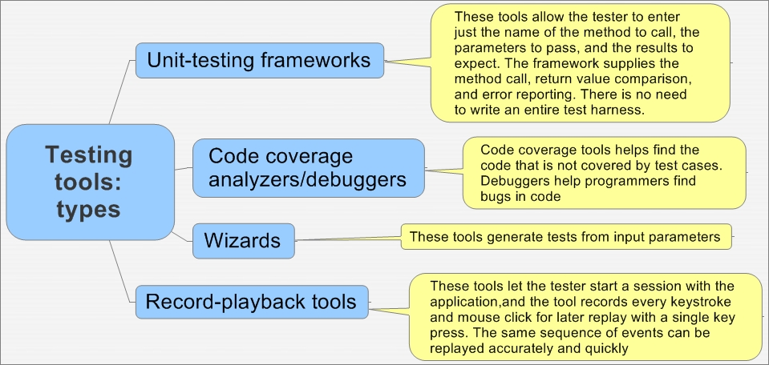
Unit Testing Tools
NUnit is a unit testing framework based on .NET platform
It’s a free tool and allows to write test scripts manually
Supports data driven tests that can be run in parallel
Uses console runner to load and execute tests
Junit for Java would be another tool
There are number of tools like CoCo, Cobertura,PureCoverage etc which look at statement coverage, branch coverage etc.
Eg. Salenium
Primarily it is for automating web applications for testing purposes, but is certainly not limited to just that.
Boring web-based administration tasks can (and should) also be automated as well

Slide 13
Requirement Traceability Matrix
Sl. No | Req Id | Brief Desc | Architecture Ref Section | Design Ref | Code File Ref | Unit Test Cases | Function/ System test cases
Pre Filled by earlier Phase
To be Filled in later

